Slide 1
CREDIT CARD FRAUD ANALYSIS CAPSTONE PROJECT
PROJECT MEMBERS:
Nikhil
Jayant
Sanjeebani

Slide 2
Understanding and Defining Credit Card Fraud
Credit card fraud is any dishonest act or behavior to obtain information without the proper authorization of the account holder for financial gain.
With rise in digital payment options, credit card frauds are on rise. On one hand any fraud committed creates a financial impact and on the other hand leads to a loss of trust, credibility and disgruntled customers. Hence it becomes imperative to understand the ways frauds are committed.
Multiple ways in which frauds are committed:
Skimming
Manipulation or alteration of genuine cards
Creation of counterfeit cards
Stolen or lost credit cards
Fraudulent telemarketing

Slide 3
Why are we solving?
Impact of Credit card frauds is ~$50Bn as per industry reports
Adapting to OTP kind of services add additional burden on customers and are time consuming creating a negative customer experience
Hence, a transaction level fraud detection mechanism is needed in order to verify the authenticity of the transaction in real time
Use of ML methods for analysis of past fraudulent data could lead to creation of a model that captures the authenticity of new transactions by recognizing similar patterns of the fraudulent transactions
Cost Benefit analysis of the data set shows that solving the problem has substantial financial benefit

Slide 4
How are we approaching the problem
Data Understanding and Preparation
EDA
Model Selection and Model Building
Model Evaluation
Finalizing the best model and the recommendations from it

Slide 5
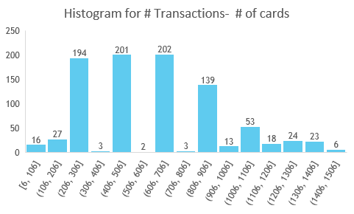
Understanding the data provided - I
The data set captures 1852394 transactions across 924 unique credit cards with 0.5% of fraudulent transactions
Interestingly, there are fewer high transacting cards (900+) and ~66% of the cards transact in 3 specific buckets of (200-300), (400-500), (600-700)

Slide 6
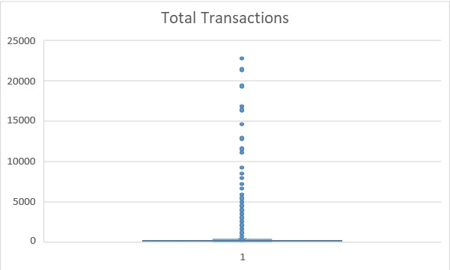
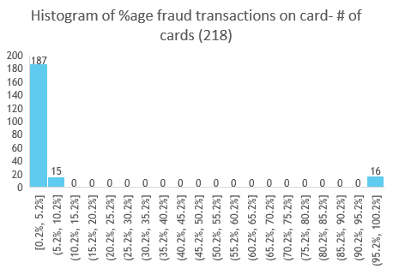
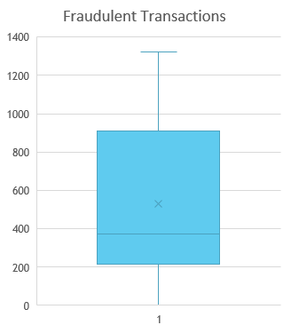
Understanding the data provided - II
Of the 924 credit cards, fraud transactions have happened only in 218 of the cards and 706 has no fraud transactions. Interestingly, only small %age of transactions on a card have fraud transactions as shown in histogram below:
Considering the Average transaction size for fraud vs non-fraud transactions, it would seem that typically fraudulent transactions happen for high ticket size transactions

Slide 7
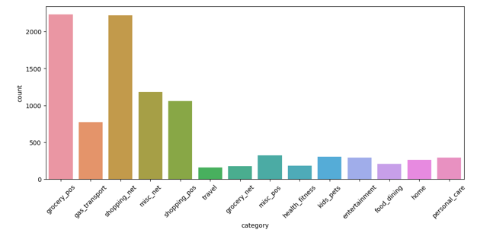
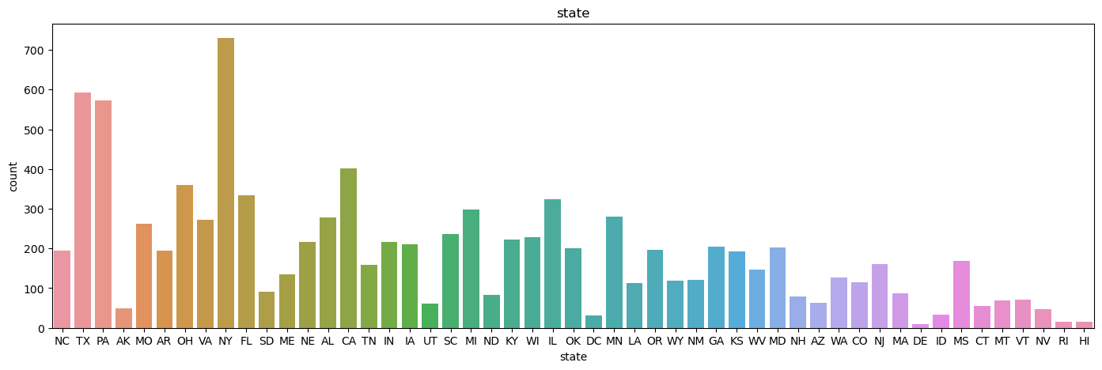
Insights from EDA I
From the above graph on shopping category wise distribution charts, it is evident that most of the fraud is encountered during grocery POS transactions . Shopping net equally contributes to the fraudulent transactions
Top 5 states which has most fraud transactions are Texas, New York, PA, California and Ohio.

Slide 8
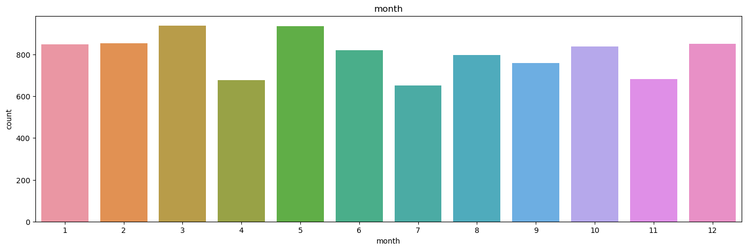
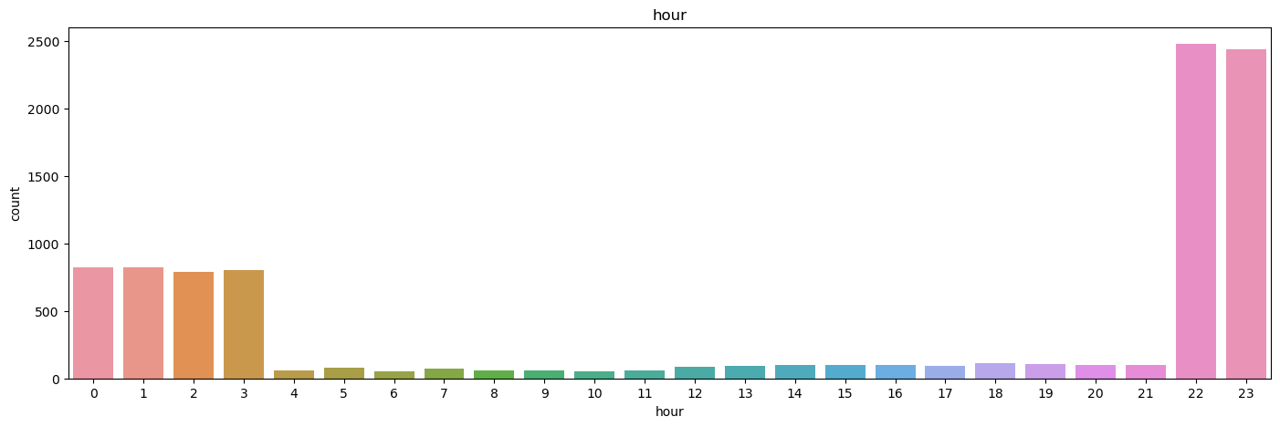
Insights from EDA II
Max fraudulent transactions were seen during the month of December, could be holiday season where people tend to buy more which gives more chance to fraudsters to make a transaction
From below graph ,evident that most of the transactions are late nights when making a fraudulent transaction becomes easy

Slide 9
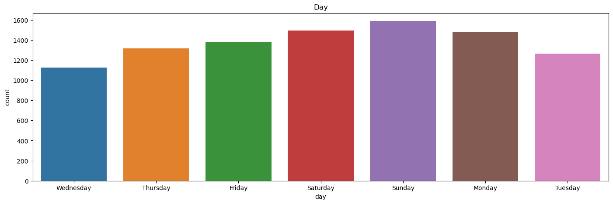
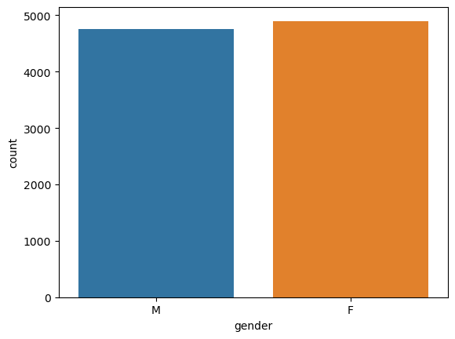
Insights from EDA III
Mostly weekends are susceptible to fraudulent transactions as this is the time when most of the shopping is done
No huge variation is found in the fraudulent behaviors based on the gender of who has made a transactions

Slide 10
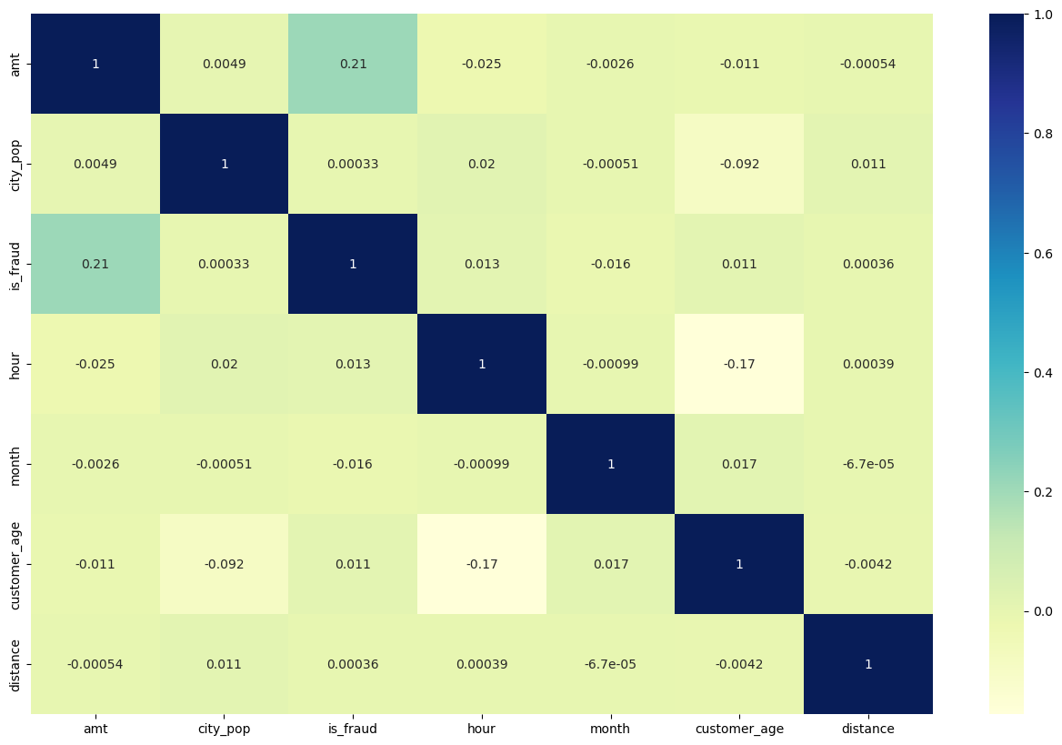
Insights from EDA IV
Understanding coorelation metrix to find the attributes which are strongly related accounting to fraudulent transactions
Looks like most of the fraudulent transactions occur for the high amount transactions

Slide 11
Model Selection I
As we know that target label is highly imbalanced approximately 99.5 % : 0.5 %
- Challenges related to imbalanced dataset are Biased predictions, Misleading accuracy.
- We will try various oversampling techniques for our class imbalance on different models:
1. Random over sampling
2. SMOTE
3. ADASYN
Various models were used iteratively to find an optimized model for consumption
Logistic Regression –
Accuracy: 0.9978370363439076 F1 score: 0.6513921113689094 Recall: 0.5235431235431235 Precision: 0.861857252494244
Decision Tree –
Accuracy: 0.9978370363439076 F1 score: 0.6365921113689094 Recall: 0.6433431235431235 Precision: 0.629857252494244

Slide 12
Model Selection II
We will start building the model with the train-test split. (At least 100 class 1 rows should be there in the test split), use the stratified split here. (80-20 ratio can be used) We need to find which ML model works good with the imbalance data and have better results on the test data.
• Logistic regression works best when the data is linearly separable and needs to be interpretable.
• KNN is also highly interpretable, but not preferred when we have a huge amount of data as it will consume a lot of computation.
• The decision tree model is the first choice when we want the output to be intuitive, but they tend to overfit if left unchecked.
• KNN is a simple, supervised machine learning algorithm used for both classification and regression tasks. The k value in KNN should be an odd number because you have to take the majority vote from the nearest neighbours by breaking the ties.
• In Gradient Boosted machines/trees. newly added trees are trained to reduce the errors (loss function) of earlier models.
• XGBoost is an extended version of gradient boosting, with additional features like regularization and parallel tree learning algorithm for finding the best split.

Slide 13
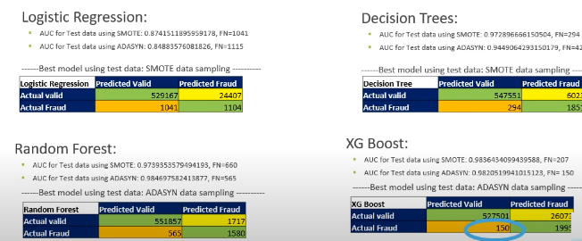
Model Selection – III (WIP)

Slide 14
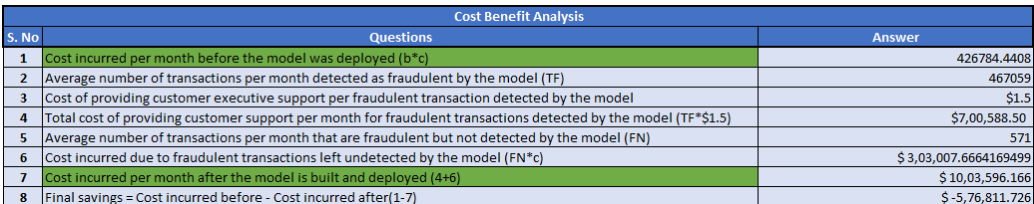
Cost Benefit Analysis
Depending on the use case, we have to account for what we need: high precision or high recall.
For banks with smaller average transaction value, we would want high precision because we only want to label relevant transactions as fraudulent.
For every transaction that is flagged as fraudulent, you can add the human element to verify whether the transaction was done by calling the customer. However, when precision is low, such tasks are a burden because the human element has to be increased.
For banks having a larger transaction value, if the recall is low, i.e., it is unable to detect transactions that are labelled as non-fraudulent.
So consider the losses if the missed transaction was a high-value fraudulent one, for e.g., a transaction of $10,000? So here, to save banks from high-value fraudulent transactions, we have to focus on a high recall in order to detect actual fraudulent transactions.
We need to determine how much profit or dollar/rupee value we are saving with our best selected model

Slide 15
Recommendation
We recommend adoption of Decision tree SMOTE data generation technique as the data is highly imbalanced and this gives us with decent results as compared to other models.
The Recall value is important here so we are considering Decision tree SMOTE technique and we will go further with this model.
We will use Cross validation technique to get a better result with 5 folds so the results obtained will help us get the proper results.
Further to reduce the number of features we will use RFECV which is Recursive feature elimination using Cross Validation.
Hyper-parameter tuning with GridSearchCV and RandomizedSearchCV will give us the exact parameters to get the best results.
The model may change if in future ,if the support cost for each transaction increases ,as avoiding single fraudulent transaction is averagely saving ~$571 whereas one transaction support cost is $1.5
It is recommended to use model that can detect maximum fraudulent transactions where as False positive cases which are NOT fraudulent but are tagged as fraudulent should be fine as the cost is less.
But it might lead to reduction in customer experience and may cause customer dissatisfaction .

